Slide 1
Mobile and Web Multimedia
CT08-3-3 & Version VC1
Web 2.0

Slide 2
Topic & Structure of The Lesson
Blogs
Wikis
Social Networks and Social Sharing

Slide 3
Learning Outcomes
At the end of this topic, You should be able to:
Identify the key factors in Web 2.0
Examine the challenges involved in Web 2.0

Slide 4
Key Terms You Must Be Able To Use
If you have mastered this topic, you should be able to use the following terms correctly in your assignments and exams:
Web 2.0

Slide 5
Introduction
Web 2.0 is a term often applied to a perceived ongoing transition of the World Wide Web from a collection of websites to a full-fledged computing platform serving web applications to end users. Ultimately Web 2.0 services are expected to replace desktop computing applications for many purposes.“ Wikipedia
“The significance of the shift to Web 2.0 for education is that it empowers teachers and learners to easily create and share their own content and resources”.

Slide 6

The New Face of Learning
“It's amazing in many ways that in just a few short years, we have gone from a Web that was primarily "read only" to one where creating content is almost as easy as consuming it”.
“One where writing and publishing in the forms of blogs, wikis and podcasts and many other such tools is available to everyone. One where we can connect not just to content but to people, ideas and conversations as well”.
“The good news for all of us is that today, anyone can become a lifelong learner. These technologies are user friendly in a way that technologies have not been in the past”
Will Richardson - Edutopia

Slide 7
Blogs and Blogging
What is a Blog (or Weblog)?
A frequently updated website, automatically archived.
Easily updated using any web browser connected to the Internet.
An online journal or newsletter, consisting of personal thoughts & commentary
Blogs include links to articles and websites.
Most blogs allow readers to leave comments on posts.
Blogs can be authored by an individual or by multiple authors.

Slide 8
Examples
Educational
Sheryl Nussbaum-Beach - Click here
Personal
Chris and Aimee - Click here
Marko - Click here
Class
Cheryl Kidd – Click here
Heretaunga Futures – Click here

Slide 9

Places to create a blog?
www.blogger.com
Check out the Emerging Technologies wiki
there are a range of places to create a blog.
Edublog, Wordpress, Blogmister etc

Slide 10
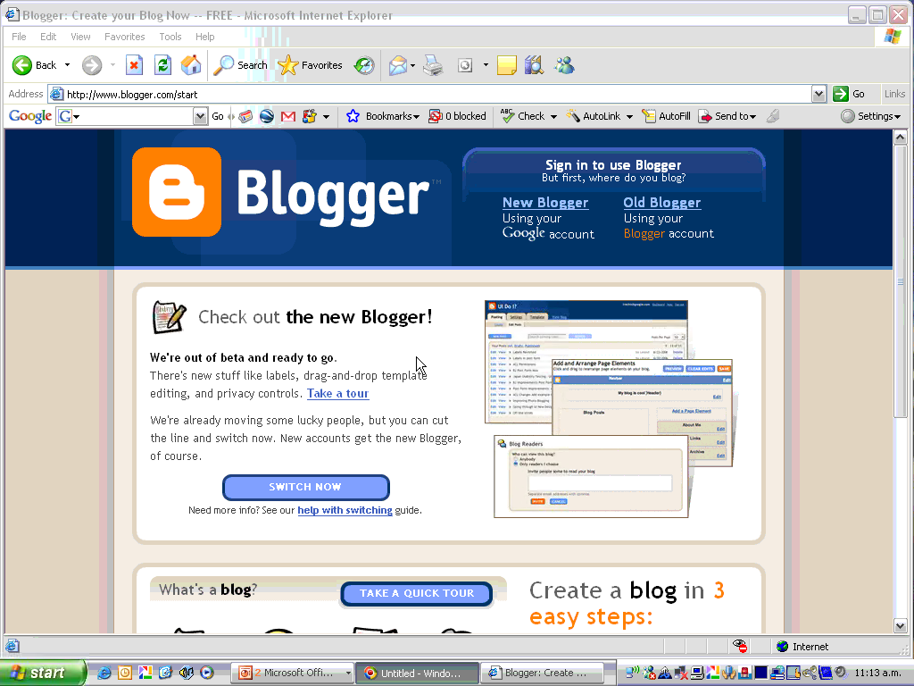
How do I make one?

Slide 11
Summary
Updated Website
Automatically Archived
Accessed by any web browser
Personal thoughts and commentary
Links Articles/Websites
Leave comments

Slide 12
Wiki
"A wiki is a web application that allows users to add content, as on an Internet forum, but also allows anyone to edit the content. Wiki also refers to the collaborative software used to create such a website” Wikipedia

Slide 13
Examples
Wikipedia – Click Here
Emerging Technologies – Click Here
Educational Software – Click Here

Slide 14



Places to make a wiki
www.wikispaces.com (Free ad turn off for educators)
www.pbwiki.com
www.wetpaint.com

Slide 15
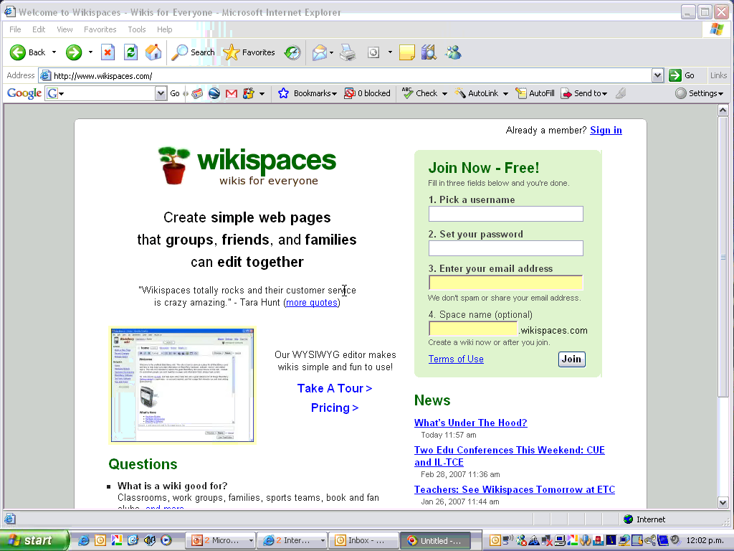
How do I make a wiki?

Slide 16
Summary
Online
Users can add content
Anyone can edit information if you choose
Add images and links
Set preferences
Invite people to join

Slide 17
Podcasting
Podcasting, made from Apple's "iPod" and "broadcasting", is a method of publishing files to the Internet, allowing users to subscribe to a feed and receive new files automatically by subscription, usually at no cost. It first became popular in late 2004, used largely for audio files."
Wikipedia
Podcasting does not actually require an iPod. One can access podcasts via the web with almost any audio software and/or with most portable digital music players. Creating podcasts can be done using free software. Podcast files can be hosted using various, free online services.

Slide 18
Podcasting
Create a podcast in the classroom using software such as Audacity. Here you can record audio and add music. (Demo Audacity)
Or you can create, find or share podcasts online at Podomatic.

Slide 19

Example
www.podomatic.com
The Web Address for HFC podcasts is:
http://hfc.podomatic.com/ – Click Here

Slide 20
Summary
Mainly Audio
Subscribe to updates
Usually free
Create using free software i.e. Audacity

Slide 21
Social Networks
I am not going to dwell too much on these sites as I am not sure how these are been currently used within education. I still thought they desired a mention as they are such a big part of Web 2.0 for teenagers and people who are involved in the arts and it is good to be aware of what our kids are in to.
"A social network is a map of the relationships between individuals, indicating the ways in which they are connected through various social familiarities ranging from casual acquaintance to close familial bonds." Wikipedia

Slide 22
Social Networks
Social networking sites typically let users develop a list of friends (aka the buddy list).
You can explore your friends' buddy lists and find people with similar interests.
You can perform a number of online activities: blogging, media-sharing, commenting, testimonials.
You can personalize your 'space' easily using themes and widgets to make it look different from other people's.

Slide 23





Examples of Social Networks

Slide 24

Bebo
My Bebo
You can:
Choose Skin
Add Photos
Add Video
People can leave messages
Widgets
Polls

Slide 25
Summary
Networks of people/like interests
Develop friends list
Explore friends buddy lists
Personalise the space
Leave comments
Share media
Often Public Spaces

Slide 26




Photo Sharing
There are many places where you can post pictures and photos. You can share them with others and search for pictures posted by other people. There are privacy options available.
http://educationalsoftware.wikispaces.com/Picture+Sharing

Slide 27



Fd’s Flickr Toys
Great for Magazine covers, badges, CD covers, calendars, motivational posters and more.
http://bighugelabs.com/flickr/

Slide 28

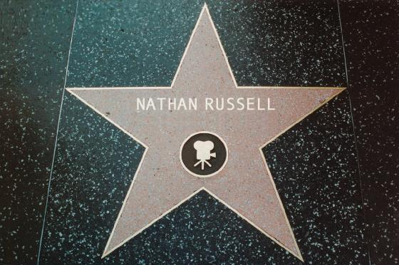

Generators
Ever wanted a star on “The Hollywood Walk of Fame”, “An Emmy” or your name for everyone to see in “Las Vegas”? Then check out the Generator Blog.
http://generatorblog.blogspot.com/

Slide 29





Video Sharing
Just as you can add images up to the web you can also add video clips. There are a range of different sites to host video such as:

Slide 30
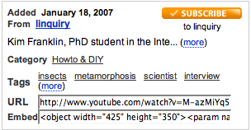
Embedding Video
You can embed videos into your blog, wiki or website from sites such as You Tube and Google Video. All you need is the html code from the website that hosts your video which you then add to your blog, wiki or website.

Slide 31
Widgets, Badges & Buttons
Widgets are objects such as slide shows, glitter text, polls, counters, etc that you can use to personalise your wiki, blog or website.
You create the widgets at a site then copy the code and paste it onto your site.
“A web widget is a portable chunk of code that can be installed and executed within any separate HTML-based web page by an end user without requiring additional compilation. Other terms used to describe a Web Widget include Gadget, Badge, Module, Capsule, Snippet, Mini and Flake. Web Widgets often but not always use Adobe Flash or JavaScript programming languages”. wikipedia

Slide 32
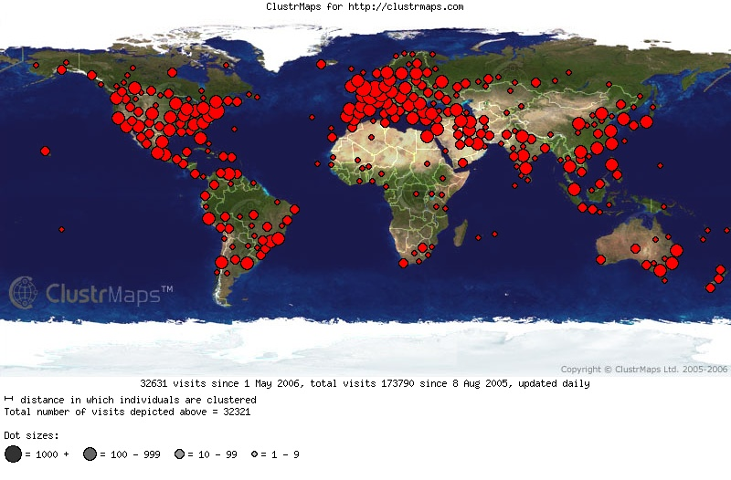


Examples
Cluster Maps – To see where people are from that are visiting your site?
Flash Gear - a range of objects to put on your site such as site counters, mini polls, puzzles.
Create slideshows from your photos, count down timers, and more on this site
http://educationalsoftware.wikispaces.com/Widgets

Slide 33

Slide Shows
If children or teachers have worked hard on a PowerPoint presentation in class, there are places where these can be uploaded so that you can share them with a wider audience.

Slide 34


RSS Feed
"It is an alternative means of accessing the vast amount of information that now exists on the world wide web. Instead of the user browsing websites for information of interest, the information is sent directly to the user."
RSS is everywhere. Have you seen these symbols?
If you have, it means that you can subscribe to an information source provided on that page. That way, whenever there is an update to that page (new information, new blog post, new photos, etc), you will receive an update in your RSS reader.

Slide 35
In Summary
Blogs
Wikis
Podcasting
Social Networking
Social Sharing
Widgets
RSS Feeds
Set up an account
(Remember it’s Free!!!)
Follow instructions
Have a play !

Slide 36
Quick Review Question
Give ONE key factor in 3G applications.
Differentiate ‘killer’ applications, consumer and business applications. Give ONE example to support your answer.

Slide 37
Summary of Main Teaching Points
Advantages of web 2.0
Challenges

Slide 38
Question and Answer Session
Q & A

